Slide 1
COVID DATA ANALYSIS
Presented By:
Hema Malini R (231038)
Hari Priya N (231035)
Kavery S (231045)
Sivagami S(231122)
Anusuya T (231010)
Gunanandhini S (231033)

Slide 2
Problem Statement
The problem is to analyze the covid cases occurred state-wise in India.
For this we are using the covid-19 India state-wise dataset as on January 17,2023 dataset.
Through the dataset we can get various data like the dead rate, active cases, the state having the highest covid cases and the state having the lowest covid cases and the problem is solved.
The technique used here is Machine Learning. This dataset is mainly used for Exploratory Data Analysis.

Slide 3
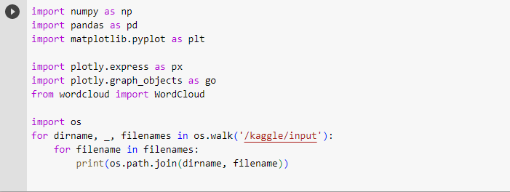
Importing Libraries
NUMPY:
Numpy stands for Numerical Python.
Numpy is used for working with arrays.
PANDAS:
Tool for reading and writing data between memory, data structures and different formats.
High performance, merging and joining of dataset.

Slide 4
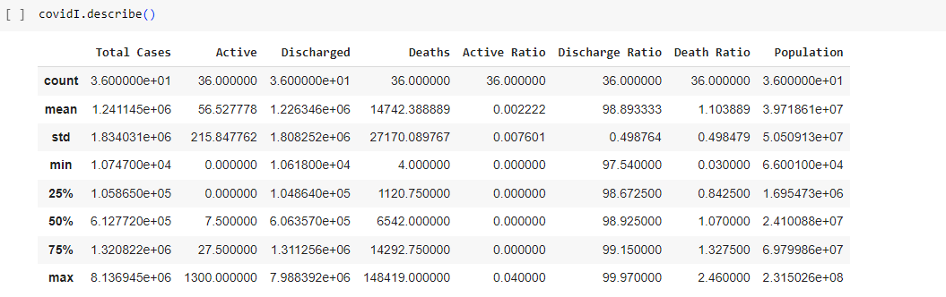
FUNCTIONS
describe():
Generates descriptive statistics of numerical columns, such as count, mean, min, max, etc.

Slide 5
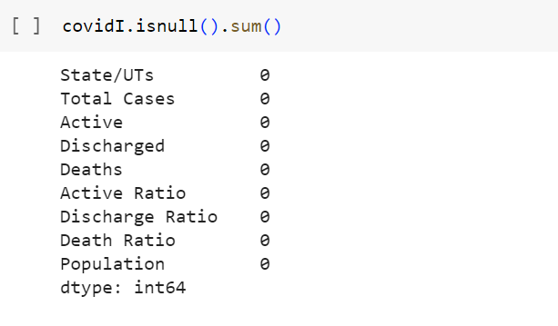
isnull(): Checks for missing values in the DataFrame.
sum(): Calculates the sum of values in columns or rows.

Slide 6
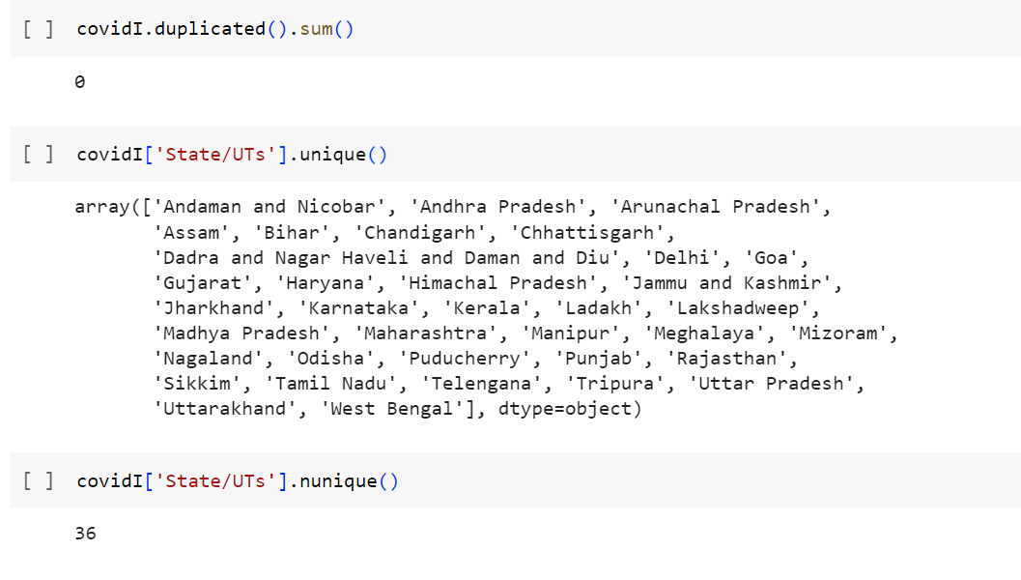
duplicate():Checks for any duplicate values in the Dataframe.
unique(): Displays the unique values in the Dataframe.
nunique():Displays the number of unique values in the Dataframe.

Slide 7
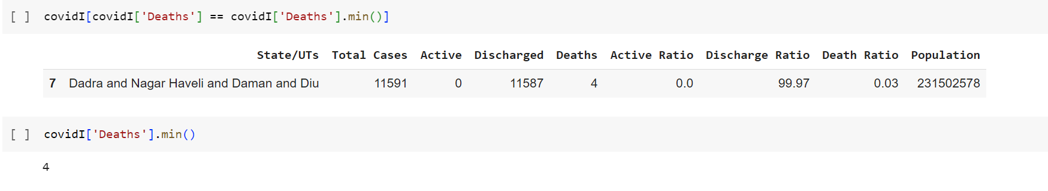
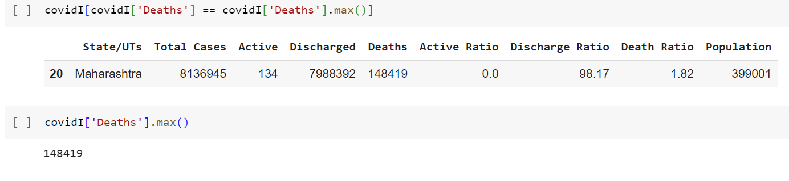
min(): It is a built-in function that returns the smallest value from the Dataframes.
max():It is a built-in function that returns the highest value from the Dataframes.

Slide 8
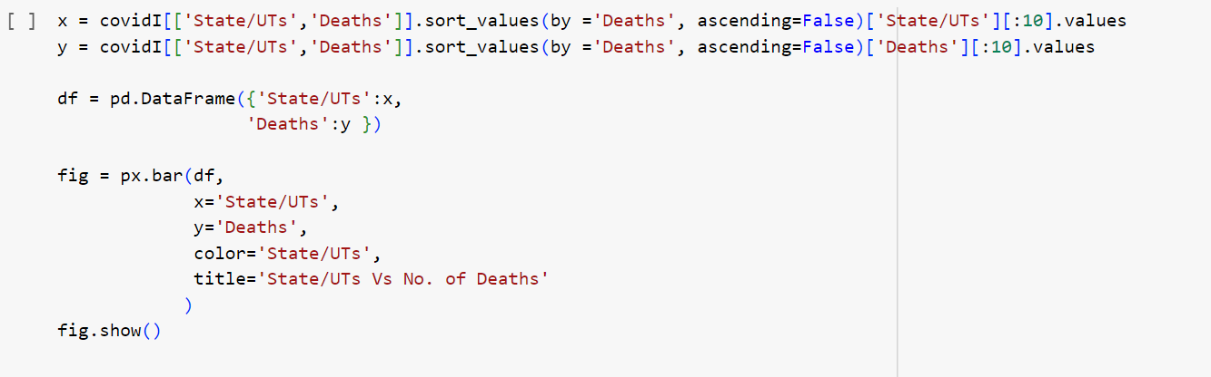
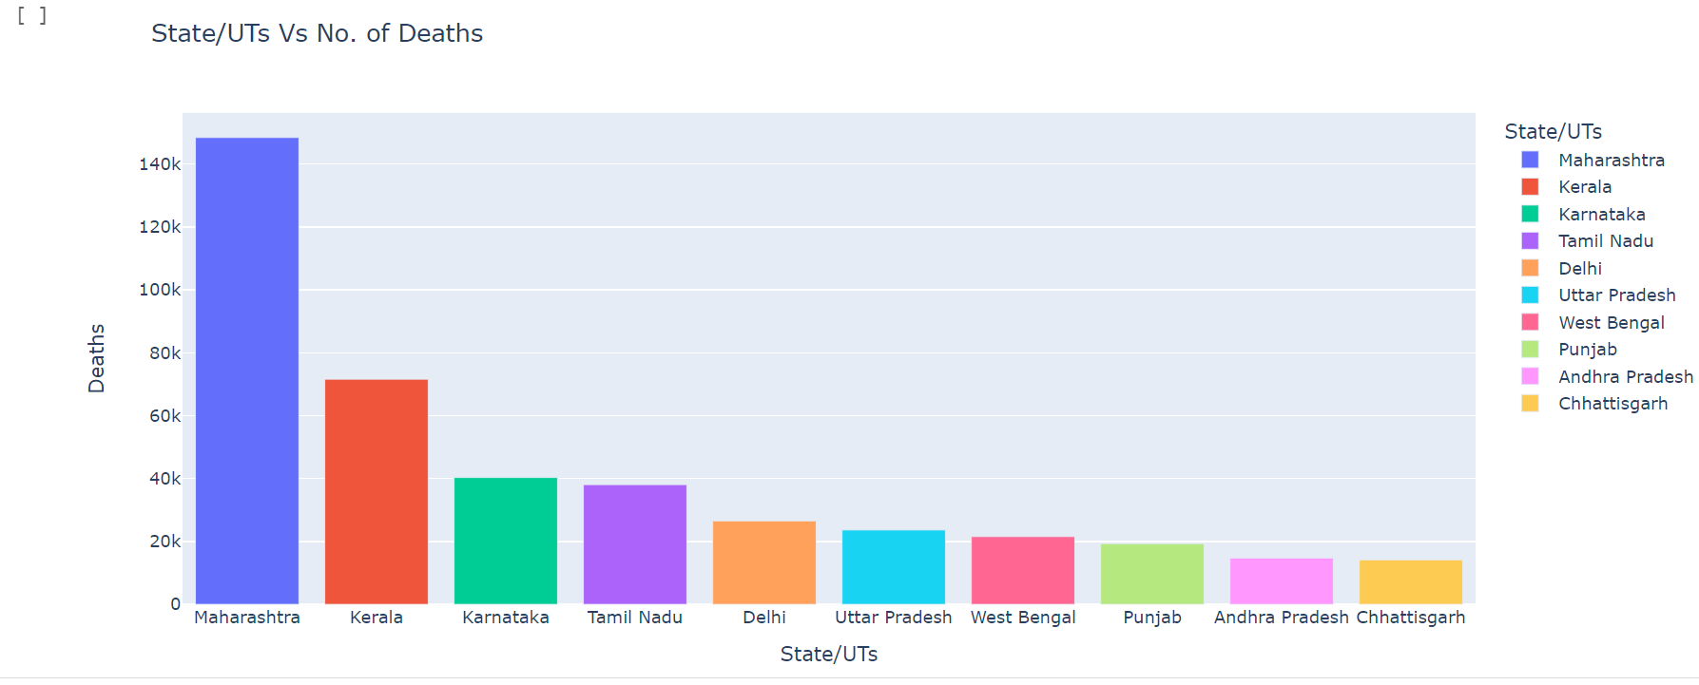
Bar Graph Representation
This bar graph shows the states having highest death rate to the lowest.

Slide 9
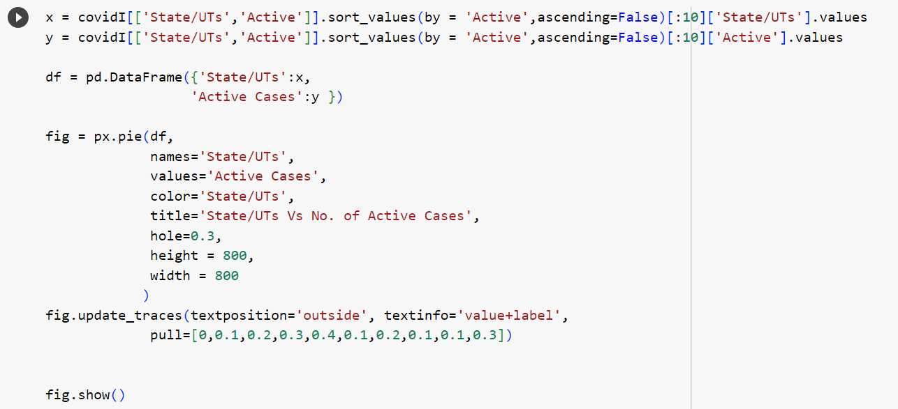
Pie Chart Representation
This pie chart shows the number of active cases in all the states

Slide 10
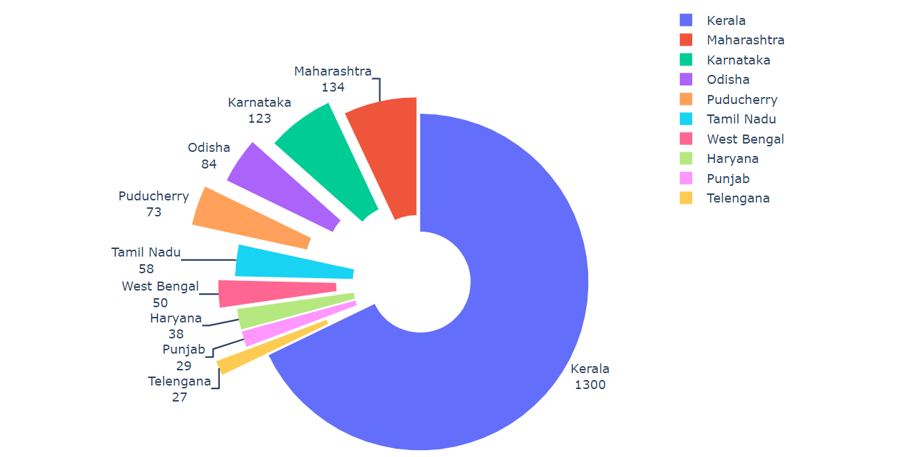

Slide 11
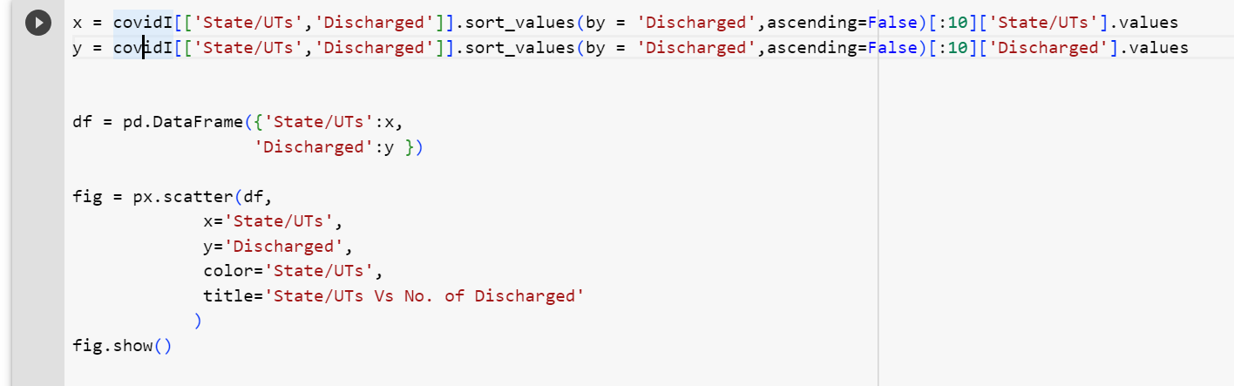
Number of discharged cases

Slide 12
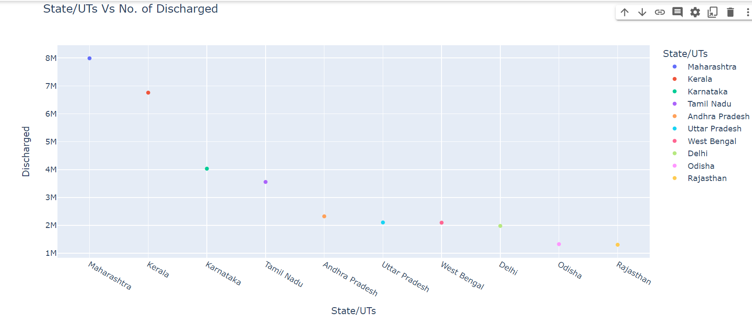

Slide 13
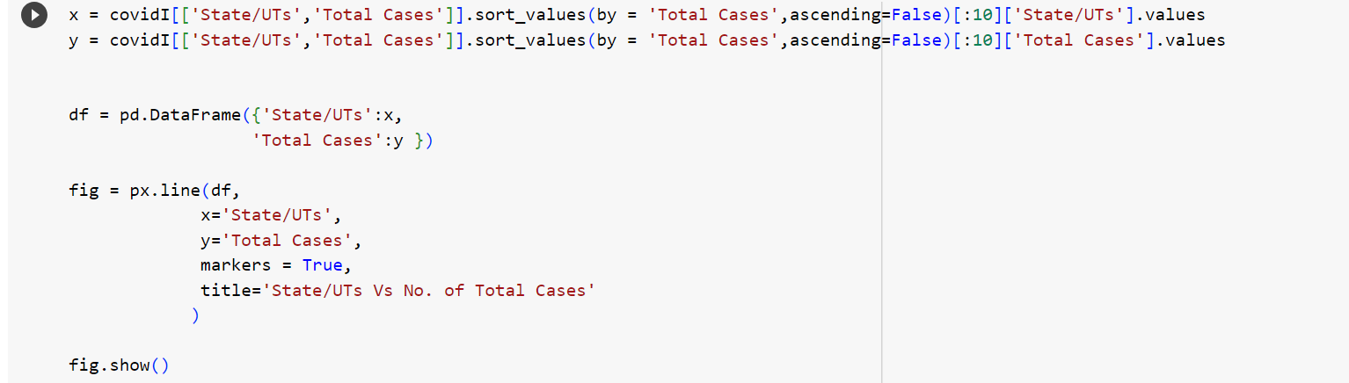
Total Number of Cases

Slide 14
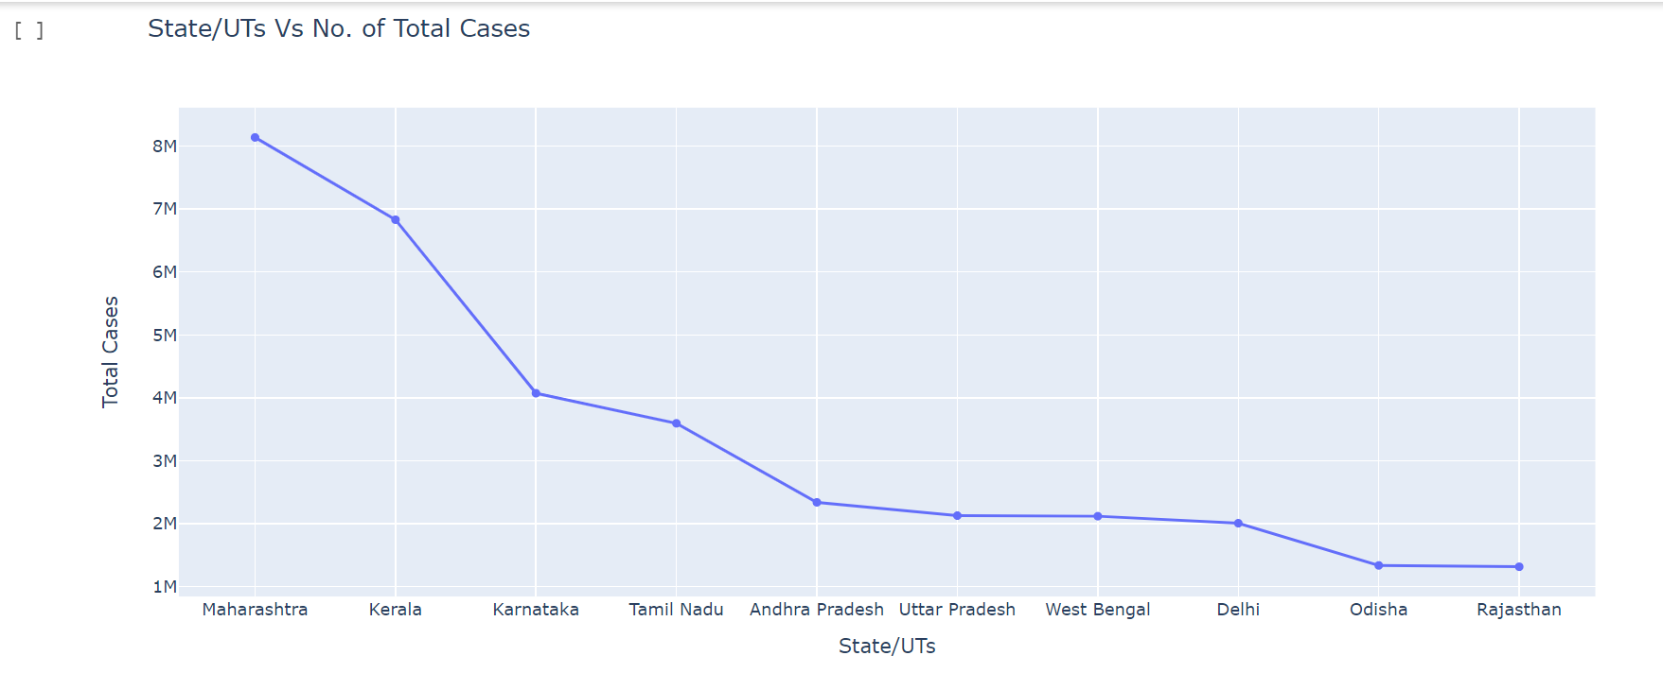

Slide 15
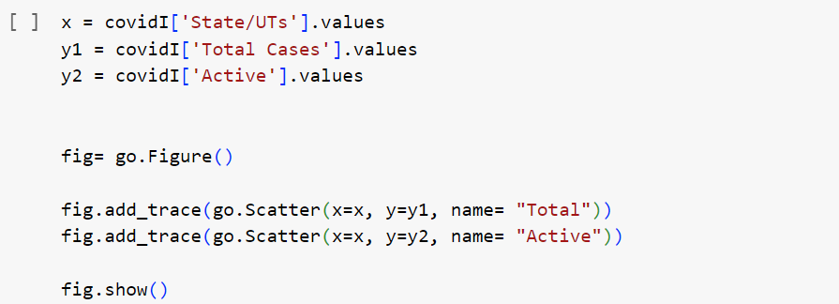
Active Cases is comparatively very less than Total cases or discharged

Slide 16
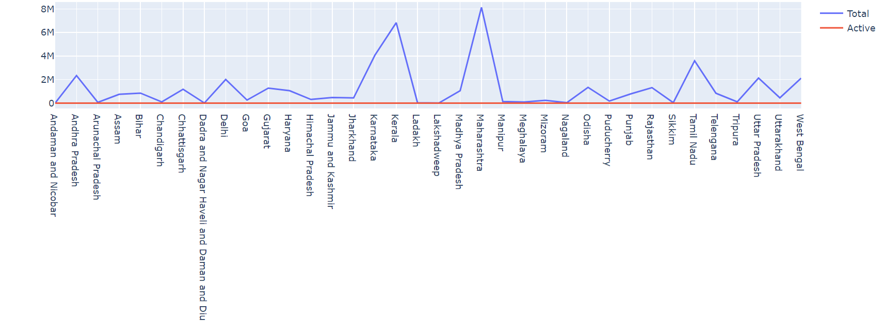

Slide 17
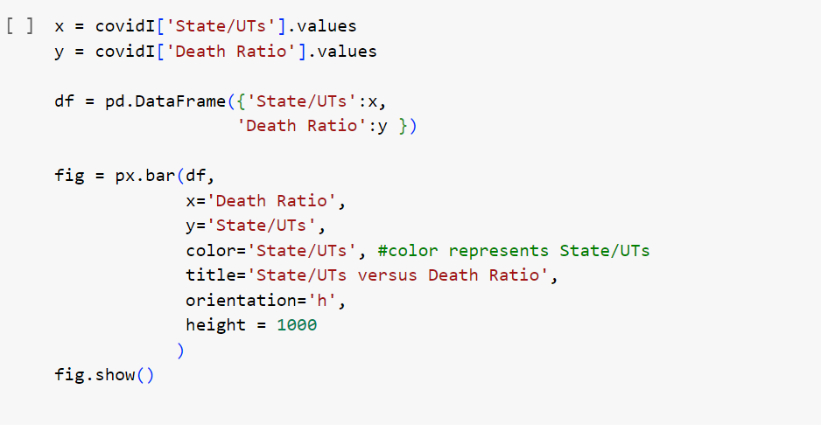
States and their Death Ratio

Slide 18
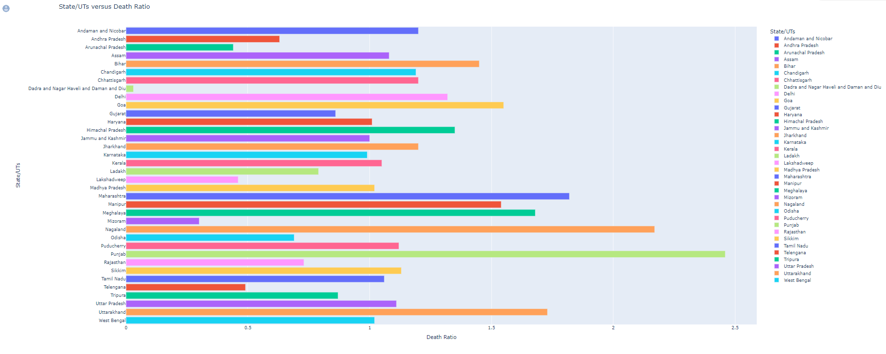

Slide 19
THANK YOU

